Slide 1
Introduction to MATLAB
Matrix Laboratory for numerical computing, scientific programming, and engineering analysis.
Notes:
Welcome, everyone. Today we are introducing MATLAB, which stands for Matrix Laboratory. Whether you are studying electrical circuits, mechanical vibrations, robotics, or biomedical signal analysis, MATLAB is the industry and academic benchmark for turning mathematical equations and raw sensor data into working engineering solutions. Notice the workbench setup illustrated here: in practice, MATLAB connects directly to physical hardware and scopes to analyze real physical signals in real time. Over the next forty-five minutes, we will look at how MATLAB is built, how it thinks in matrices, and how you can use it immediately in your lab courses. Let us start with where MATLAB came from and how its workspace is organized.

Slide 2
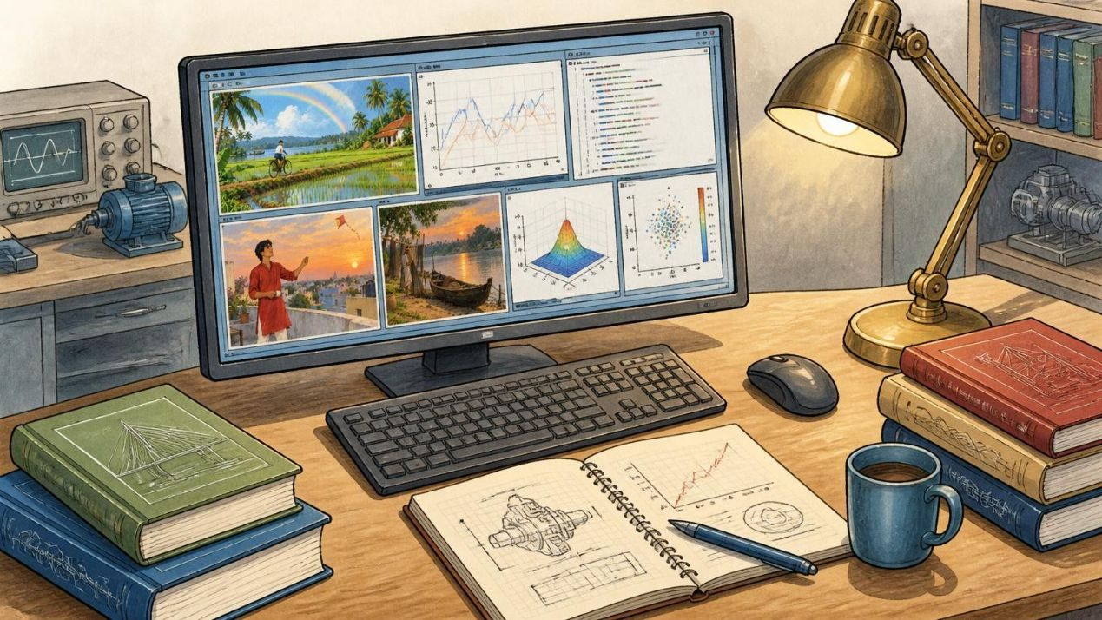
From Matrix Calculator to Technical Computing Environment
In the 1970s, Cleve Moler created MATLAB to give students access to matrix methods and numerical libraries LINPACK and EISPACK. After MathWorks was founded in 1984, MATLAB grew into a broader technical computing platform.
Command Window
Editor & Live Editor
Run commands directly.
Write scripts and functions.
Workspace Browser
Figure Window
Inspect variables and data.
Visualize results.
Fig. 2.1 The standard MATLAB desktop layout with docked tool windows
Key rule
Variables stay in memory until cleared with clear or closed.
2
Notes:
To understand MATLAB, it helps to understand its history. In the 1970s, Cleve Moler created it so students could work with matrix methods and numerical libraries such as LINPACK and EISPACK. MathWorks was founded in 1984, and MATLAB grew into a broader technical computing platform. Use the illustration on the right as a guide to the environment's main areas: enter and test commands in the Command Window, write reusable scripts and functions in the Editor, inspect variables and data in the Workspace, and view plots in the Figure Window. For example, after calculating a value in the Command Window, you can check the resulting variable in the Workspace and then plot it in a Figure Window. The key rule at the bottom is that variables remain in memory until you clear them or close MATLAB. Next, we will see why MATLAB's matrix syntax makes mathematics readable.

Slide 3
CORE LINEAR ALGEBRA
MATLAB Makes Matrix Mathematics Readable
MATLAB treats variables natively as arrays or matrices, without explicit dimension declarations or nested pointer loops.
COMMAND WINDOW CODE
INNER PRODUCT EXPANSION
A = [1 2; 3 4];
B = [5 6; 7 8];
C = A * B
EVALUATED OUTPUT
Operator syntax: * performs matrix multiplication (inner dimension match); use .* for element-by-element array multiplication.
Vectors, matrices, and multidimensional arrays are core structures. Semicolons separate rows; spaces separate columns; indexing starts at 1. Matrix operations support modeling, linear algebra, and numerical equation solving; fundamentals include variables, conditions, loops, and functions.
Whole-array operations use optimized BLAS libraries instead of slow manual nested loops. Automation turns repetitive calculations into reusable scripts; parameterized functions can use inputs, local scope, and formatted output arguments.
C =
19 22
43 50
3
Notes:
This slide highlights MATLAB's strength in mathematical readability. In languages like C or Java, computing the product of two two-by-two matrices requires allocating memory, declaring variables, and writing nested loops over rows and columns. In MATLAB, you write A equals bracket one two semicolon three four bracket, and C equals A times B. Look at the formula: the asterisk operator carries out standard row-by-column linear algebra multiplication. Row one times column one gives one times five plus two times seven, which is nineteen. Row one times column two gives one times six plus two times eight, which is twenty-two. Row two times column one gives three times five plus four times seven, which is forty-three; row two times column two gives three times six plus four times eight, yielding fifty. If you want element-wise multiplication instead of matrix multiplication, use dot-star. The lower text connects arrays and indexing with programming fundamentals, optimized whole-array operations, and reusable functions. Now that we can calculate matrix equations, let us see how MATLAB handles real data and generates plots.

Slide 4
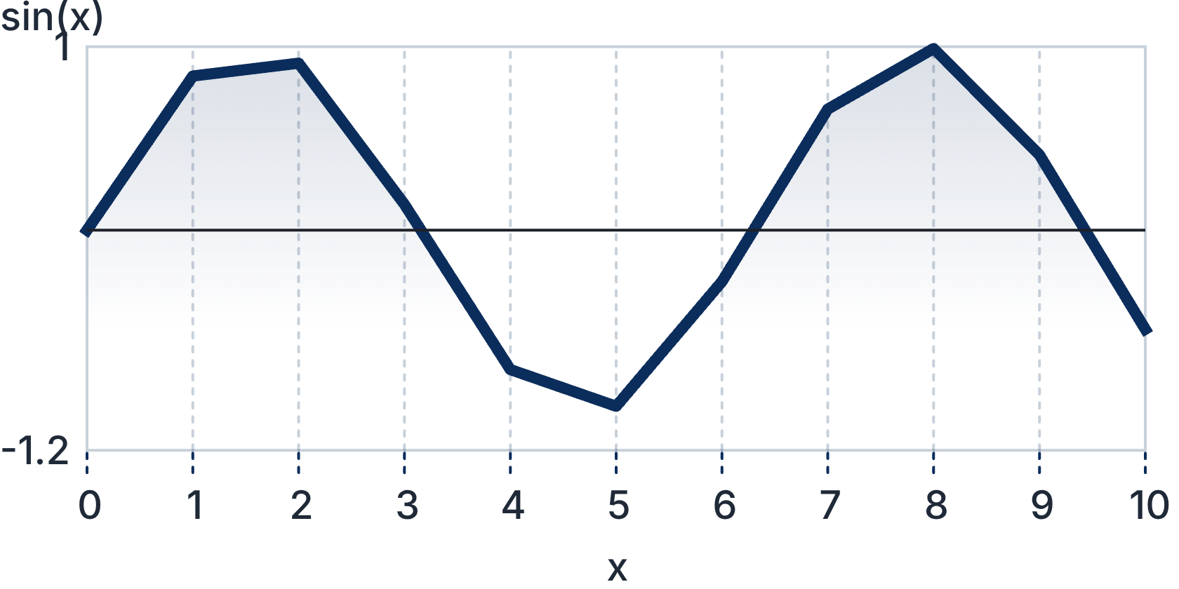
From Raw Data to a Clear Scientific Story
x = 0:0.1:10;
y = sin(x);
plot(x, y);
xlabel('x');
ylabel('sin(x)');
title('Sine Wave');
grid on;
Fig. 4.1 Continuous sine curve sampled across 0 to 10 radians with visible grid lines
Import CSV and Excel data; calculate mean, variance, correlation, and other statistics.
Visualize with line plots, scatter plots, bar charts, and 3-D visualizations.
Look for trends, patterns, and relationships before making decisions.
4
Notes:
Data science and laboratory experiments depend on moving quickly from messy measurements to an interpretable plot. In MATLAB, the script shown on the left generates the exact curve rendered on the right. Look at line one: x equals zero colon zero point one colon ten creates a row vector from zero to ten in steps of one-tenth. Line two computes the sine of every single element in that vector in one call. The plot command renders the line, while xlabel, ylabel, title, and grid on turn a raw curve into a properly documented scientific figure. Beyond two-dimensional line plots, MATLAB supports scatter plots for correlation analysis, bar charts for categorical comparison, and three-dimensional surface meshes for multivariable functions. Before making engineering decisions, visualizing trends and outliers is essential. But what happens when our system is dynamic, involving differential equations, feedback loops, and motors? For that, we step into Simulink.

Slide 5
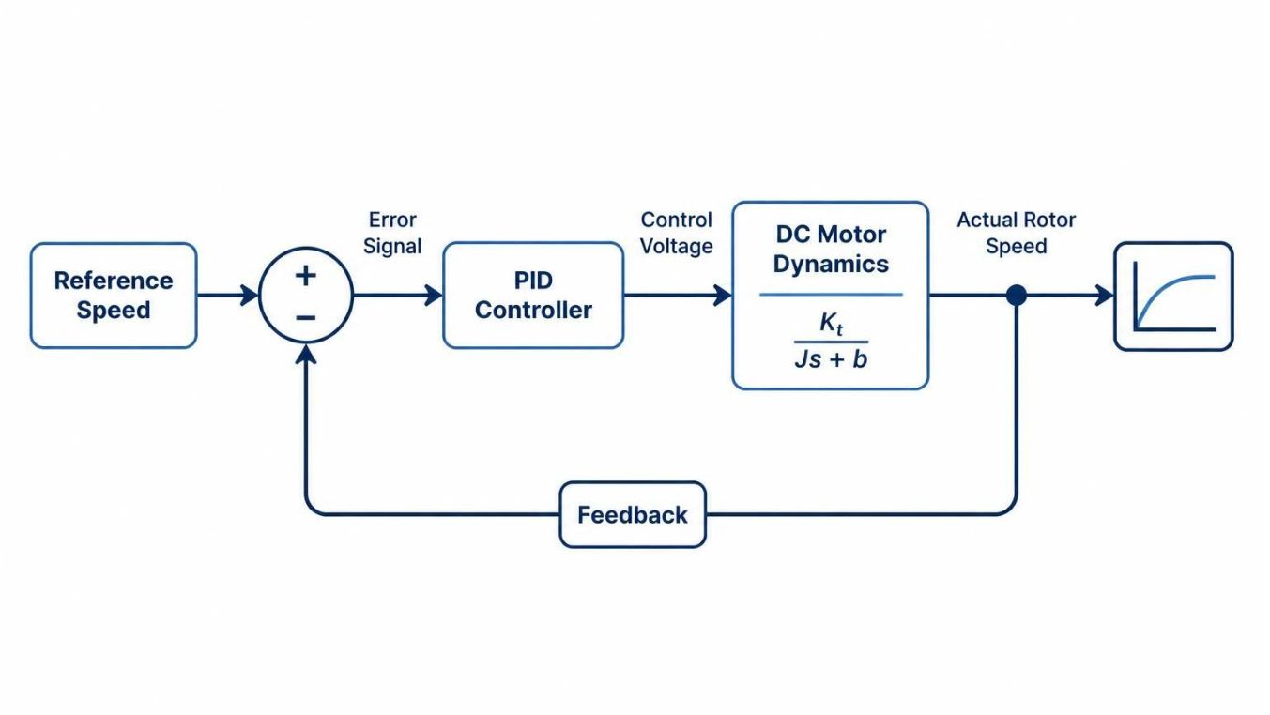
Simulink Turns System Ideas into Experiments
MATLAB is the programming and numerical environment; Simulink is the graphical, block-diagram modeling environment. They work together to model, simulate, and analyze dynamic systems.
From blocks to behavior
Interconnected blocks represent signals, dynamics, controllers, and feedback. Simulate behavior before physical implementation.
Electric-motor speed
Compare desired speed with measured speed; a PID controller adjusts motor voltage, while feedback helps hold speed under load changes.
Fig. 5.1 Feedback loop for electric motor velocity control in Simulink
Automotive engineering
Industrial automation
Aerospace
5
Notes:
Students often wonder how MATLAB and Simulink relate to each other. Think of MATLAB as the command console and calculation engine, while Simulink is the virtual laboratory workbench. In Simulink, instead of writing lines of differential equations, you drag blocks representing mathematical integrators, transfer functions, controllers, and sensors, wiring them together into a visual block diagram. Examine the infographic on the right showing a classic electric motor speed control loop: you set a target speed, the summing junction measures the difference between target and current speed, the PID controller adjusts the motor voltage, and the feedback loop corrects for disturbances before building physical prototypes. In automotive, aerospace, and robotics companies, engineers test thousands of virtual hours in Simulink before a single piece of metal is cut. Next, let us explore how MATLAB handles real-world physical waveforms through digital signal processing.

Slide 6
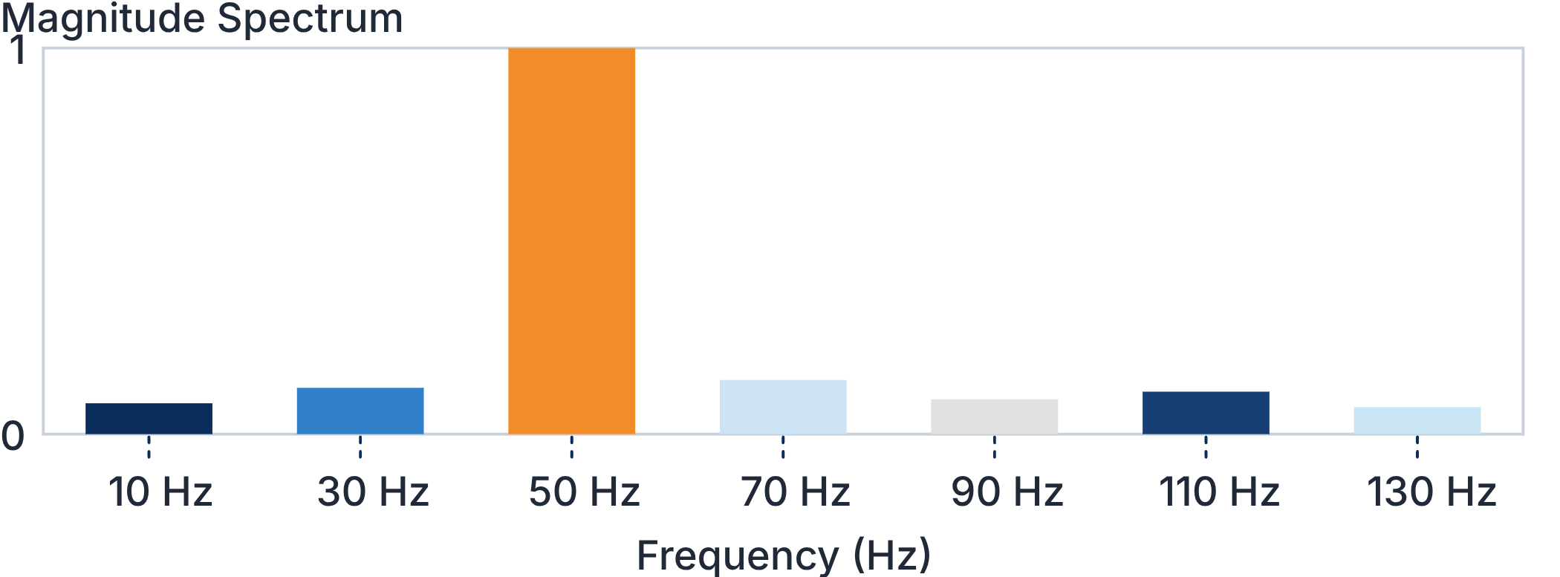
DIGITAL SIGNAL PROCESSING
See the Signal in Time and Frequency
Physical signals from microphones, antennas, vibration probes, and medical sensors arrive with noise. MATLAB transforms raw time waveforms into clear spectral insights.
1. Time Domain Waveform
2. Fast Fourier Transform
3. Digital Noise Filtering
A 50 Hz pure tone corrupted by broadband Gaussian sensor noise. In the raw time series, the underlying frequency structure is hidden by noise spikes.
The fft() algorithm decomposes time-domain samples into constituent sinusoidal frequencies, revealing an unmistakable energy peak at 50 Hz.
Designing a low-pass or band-pass Butterworth filter with butter() removes high-frequency hiss, recovering the original clean sinusoid.
clean = filter(b, a, x_noisy);
x_noisy = sin(2*pi*50*t) + noise
Y = abs(fft(x_noisy)/N);
Telecommunications
1
Carrier modulation, channel estimation, and RF demodulation.
Audio Engineering
2
Echo cancellation, equalization, and speech synthesis.
Radar & Sonar
3
Doppler frequency shift extraction and target distance profiling.
Fig. 6.1 Single-sided amplitude spectrum showing dominant 50 Hz fundamental frequency
6
Notes:
Signal processing is one of MATLAB's most prominent real-world applications. When an acoustic sensor, an electrocardiogram lead, or a radio receiver picks up a signal, the data arrives mixed with ambient electrical interference. In the time domain, looking at voltage over time, the signal often appears as a jagged, unreadable mess. But when you apply the Fast Fourier Transform using the fft function, shown in step two and plotted in the spectrum chart below, the mathematical transformation reveals the hidden frequencies. Notice the dramatic spike at fifty hertz: even with random noise spread across the spectrum, the underlying frequency jumps out immediately. From there, you can design a digital filter using functions like butter or designfilt to reject unwanted bands and reconstruct the clean message. Just as one-dimensional signals are arrays over time, two-dimensional signals are matrices of pixels. That brings us directly to image processing.

Slide 7
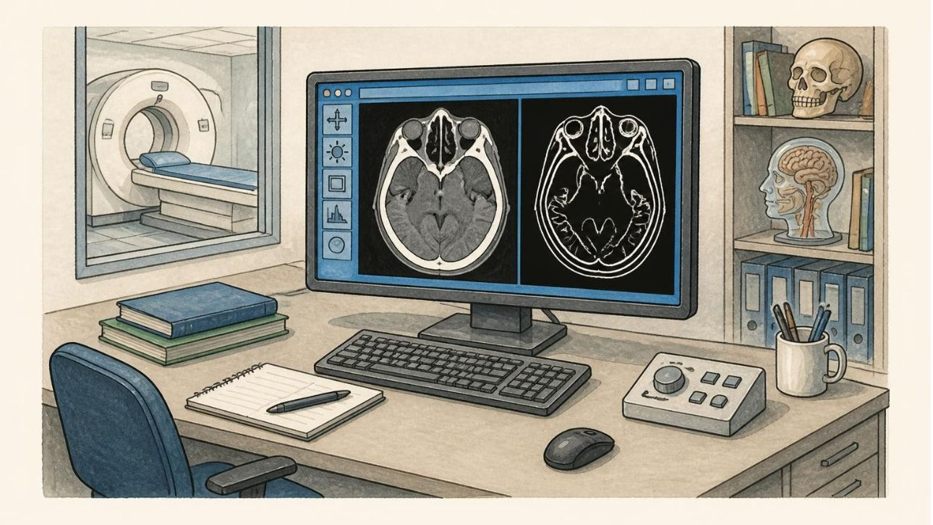
IMAGE PROCESSING & COMPUTER VISION
Images Become Measurable Data
MATLAB represents images as pixel-intensity matrices, so visual data can be analyzed numerically.
Read & display
Enhance
Read, display, and manipulate grayscale images as 2D intensity matrices or color images as 3D RGB arrays.
Reduce noise and enhance image quality with Gaussian or median filtering (medfilt2()).
Edges & regions
Extract features
Fig. 7.1 Medical CT imaging analysis: grayscale scan matrix and segmented boundary map
Detect edges with Sobel or Canny (edge(I, 'Canny')); segment regions of interest with thresholding or watershed.
Use regionprops() to extract surface area, perimeter, circularity, and centroid coordinates for further analysis.
Applications: medical-imaging research, industrial inspection, and computer vision. Scope: research and analysis support, not a clinically validated diagnosis.
7
Notes:
Because MATLAB's core foundation is the matrix, digital image processing feels completely natural. When you load a grayscale picture with imread, MATLAB treats it as a two-dimensional grid of numbers ranging from zero for black to 255 for white. For color images, it is an M-by-N-by-three tensor representing red, green, and blue color channels. On the left, Fig. 7.1 illustrates a research application: analyzing a medical CT scan slice. By applying mathematical convolution filters, an engineer can suppress scanner noise, detect organ boundaries with algorithms like Canny edge detection, and measure geometric properties like tumor perimeter or cross-sectional area with regionprops. Notice the essential disclaimer at the bottom: in biomedical engineering, MATLAB serves as a powerful computational research tool, but real-world diagnostic deployment requires formal clinical regulatory certification. Once we can extract features from images or signals, our next step is to teach machines to recognize patterns automatically using machine learning.

Slide 8
Machine Learning Adds Prediction and Pattern Recognition
Machine learning helps build predictive models from data.
From data to prediction
Prepare data and extract useful features.
Classification predicts a category or label; regression predicts a numerical value.
Train, test, and evaluate models, including neural networks and deep learning.
Examples: house-price prediction, image classification, and medical-image dataset research.
Some advanced capabilities require products such as Statistics and Machine Learning Toolbox or Deep Learning Toolbox.
Neural-network model
A simple view of how features become a predicted class
Input layer
Hidden layers
Output layer
Prepared features
Learn patterns
Predicted class
8
Notes:
Machine learning uses data to recognize patterns and make predictions. Start with the three-part diagram: prepared features enter the network, hidden layers learn patterns, and the output is a predicted class. For example, a set of measurements from a home can be used to predict its price; that is regression because the result is a number. By contrast, sorting an image into a category is classification. In practice, prepare the data, extract useful features, then train, test, and evaluate a model so you can check how well it performs on examples it did not learn from. Neural networks and deep learning are among the model approaches students may encounter. Some advanced capabilities require products such as Statistics and Machine Learning Toolbox or Deep Learning Toolbox. The examples on the slide include house-price prediction, image classification, and medical-image dataset research. Next, we will step back and consider MATLAB's broader engineering trade-offs.

Slide 9
ENGINEERING PERSPECTIVE
One Platform, Many Engineering Trade-Offs
APPLICATIONS BY DISCIPLINE
Advantages
Discipline | Example applications
Electrical & mechanical | Circuit analysis and power systems; dynamics and vibration
Robotics & aerospace | Trajectory planning and control; flight dynamics and simulation
Computer & industrial engineering | Signal processing, image analysis, statistics, and optimization
Mathematical functions, scientific visualization, specialized tools, and fast prototyping.
Limitations
Commercial licensing cost and paid toolboxes; open-source alternatives such as Python for some projects.
9
Notes:
MATLAB can support work across engineering fields. The table pairs electrical with mechanical applications, robotics with aerospace, and computer with industrial engineering. For example, a robotics student might use trajectory planning and control to explore how a robot moves. The comparison panel balances benefits—mathematical functions, scientific visualization, specialized tools, and fast prototyping—against licensing costs and paid toolboxes. Python is one open-source alternative for some projects. The right tool depends on a project's goals and constraints. Next, we will look at ways to begin learning MATLAB with official resources.

Slide 10
NEXT STEPS & RESOURCES
Start Small, Build, and Keep Learning
Learning roadmap
Official learning resources
Learn commands, variables, and arrays
Practice conditions, loops, and functions
Learn plotting and data analysis
Choose a specialization for your field
Complete a small practical project and explain the result
MATLAB Academy:
https://matlabacademy.mathworks.com/
MATLAB Documentation:
https://www.mathworks.com/help/matlab/
Official MATLAB:
https://www.mathworks.com/products/matlab.html
Thank You for Your Attention — Questions and Discussion.
10
Notes:
To conclude our introductory workshop, the secret to learning MATLAB is not memorizing hundreds of functions from a reference manual; it is starting with a tiny problem and building upward. Begin this week with the two-hour MATLAB Onramp hosted at MATLAB Academy—it runs entirely in your web browser with interactive automated grading and requires no software installation. Once comfortable with basic variables and array indexing, write your own functions, plot experimental lab data, and choose one toolbox that aligns with your engineering major. When you get stuck, the official documentation at mathworks.com/help is arguably the finest technical reference in computational science, full of complete runnable examples. Thank you for your time and active attention today. I will now open the floor for any questions, code demonstrations, or discussion.

